Slide 1
Cloud: Enabling Science
Stephen Litster, Ph.D.
Mike Tarselli, Ph.D., MBA
Specialist Leaders – HCLS Data & AI
Amazon Web Services

Slide 2



Try it now: https://nova.amazon.com/

Slide 3

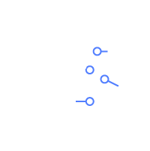





Drug Discovery | Use Cases, Workloads, Outcomes
Connected Lab
Genomics &
Precision Medicine
Structure Based Drug Discovery
Image Analysis & Insights
Generative Biology and Chemistry
Quantum Computing
Lab Data Transfer and Storage
Production Genomics Pipeline at Scale
10x cost reduction from $350K to $35K
Cryo-EM imaging analysis using Parallel Cluster
Bio Foundational Model training
Increase speed and accuracy
Working with AWS, Foundation Medicine accelerated their cloud journey by moving data to AWS quickly and securely with AWS DataSync. Learn how 23andMe leveraged AWS partner Weka.io and services like Amazon S3 and AWS Batch for full migration to the cloud, a process that took only 4 months.
AstraZeneca‘s Genomics Data Processing Solution Runs 51 Billion Tests in 1 Day on AWS using AWS EC2 (FPGA) instances, AWS Lambda and AWS Batch. Roche uses AWS HealthOmics to 80% reduction
in analysis time.
A pharma customer deploying AWS-optimized code for a 1M vCPU virtual screening run in the cloud against a 1.4B molecule library reduced run time to <24 hours and significantly lowered costs from $350K to $35K.
Vertex Pharmaceuticals Reduces Costs of Cryo-EM Data Storage and Processing by 50% Using AWS. Lilly uses Amazon FSx Luster and AWS Parallel Cluster for high throughput data analysis.
A-Alpha Bio Boosts the Performance of Protein-Protein Interaction Prediction Using NVIDIA BioNeMo on AWS. Evolutionary Scale, a frontier AI research lab for biology, launched ESM3 - a milestone AI model capable of generating novel proteins.
Design and evaluate molecules and inform wet lab experiments.
End to End R&D
42 days from sequence to clinical batch
Moderna delivered the first clinical batch of its COVID-19 vaccine only 42 days after the sequence of the virus was released with AWS as their preferred cloud provider.
Notes:
1/

Slide 4
GPUs + SageMaker HyperPod

Slide 5
Cluster size growth leads to higher failure
Mean time to failure by cluster size (in hours)
 | Number of Nodes In Cluster
Failure Rate (per node per hour) | 4 | 8 | 16 | 32 | 64 | 128 | 256 | 512
0.01% | 2500 | 1250 | 625 | 313 | 157 | 79 | 40 | 20
0.02% | 1250 | 625 | 313 | 157 | 79 | 40 | 20 | 10
0.05% | 500 | 250 | 125 | 63 | 32 | 16 | 8 | 4
0.07% | 358 | 179 | 90 | 45 | 23 | 12 | 6 | 3
0.10% | 250 | 125 | 63 | 32 | 16 | 8 | 4 | 2
A 128 node (1024 GPU) cluster, will experience one failure every 12 to 40 hours

Slide 6
Optimize for price-performance ‘Sweet Spot’
GPU, AWS ML Accelerators, And FPGA-based EC2 instances
GPUs
AI/ML accelerators and ASICs
FPGAs
G5
G5g
G6
G6e
P4d
P5
P5en
DL2q
Inf2
Trn2
VT1
DL1
F2
Core HPC workloads
AI/ML, Core GenAI workloads
AI/ML, Core GenAI PoCs
Illumina Genomics
Molecular Dynamics. (GROMACS, NAMD)
Cryo-EM (CryoSpark, Relion)
Computational Chemistry
Genomics secondary Analysis (NVIDIA Parabricks)
Generative Biology and protein Language models(AlphaFold, ESMFold)
Generative Chemistry (MegaMolBART)
LLMs training for text analysis
DL for imaging (clinical and research)
Pytorch 2.0, AlphaFold
(*Check with Trn/Inf teams on Neuron model support)
Illumina DRAGEN secondary analysis
Illumina ICA (SaaS platform)
Notes:
To address the specific needs and the general customer requirements around faster time-to-train, lower costs and higher performance, we have been building out our portfolio of hardware-accelerated instances. We have a broad portfolio of accelerated computing instances. These include FPGA, GPU, and AWS custom accelerator-based instances. Custom accelerator-based instances are designed as performance and cost-optimized training and inference in the cloud. These include AWS Inferentia and Trainium accelerator-based instances. Other instances are based on GPUs and other hardware accelerators from Nvidia, AMD, and Intel.

Slide 7
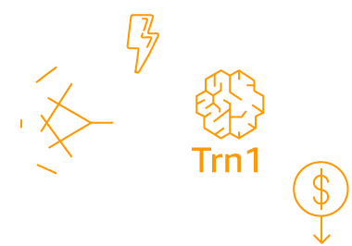

AWS provides flexibility but also reserved capacity and scale to 20 exaflops
THE LARGEST-SCALE ML INFRASTRUCTURE IN THE WORLD
Second-generation EC2 UltraClusters
Over 20,000 H200 GPUs (P5en) or 30,000 Trainium Accelerators (Trn)
Nonblocking petabit-scale network infrastructure
Redesigned for 16x larger scale and lower latency with second-gen EFA
High-throughput, low-latency storage from Amazon FSx for Lustre
20,000 H200 GPUs
3,200 Gbps Elastic Fabric Adapter (EFA)
Scalable low- latency storage
Petabit-scale nonblocking network infrastructure
Petabytes per second throughput, billions of IOPS

Slide 8
SageMaker HyperPod provides a resilient cluster for model development and deployment
Deep health checks
Automated hardware health monitoring
Auto-repair & job auto-resume
Identify and replace potentially problematic instances during cluster creation and updates
Automatically monitors cluster health for hardware failures and remediates the issue
Automatically resumes the training process from the last saved checkpoint
8
Notes:
Amazon SageMaker HyperPod makes it easier for you to train foundation models without interruptions or delays.
First, if a hardware failure occurs, it detects the failure, replaces the faulty instance, and resumes training from the last saved checkpoint.
Secondly, It enables your data and models to be efficiently distributed across thousands of accelerators in the cluster and processed in parallel.
It helps you iteratively pause, inspect, and optimize model training by automatically taking frequent checkpoints.
With this new capability, you will see dramatic improvements by training models for weeks, or months without disruption – saving up to 40% time to train foundation models.

Slide 9
Enabling Technologies

Slide 10
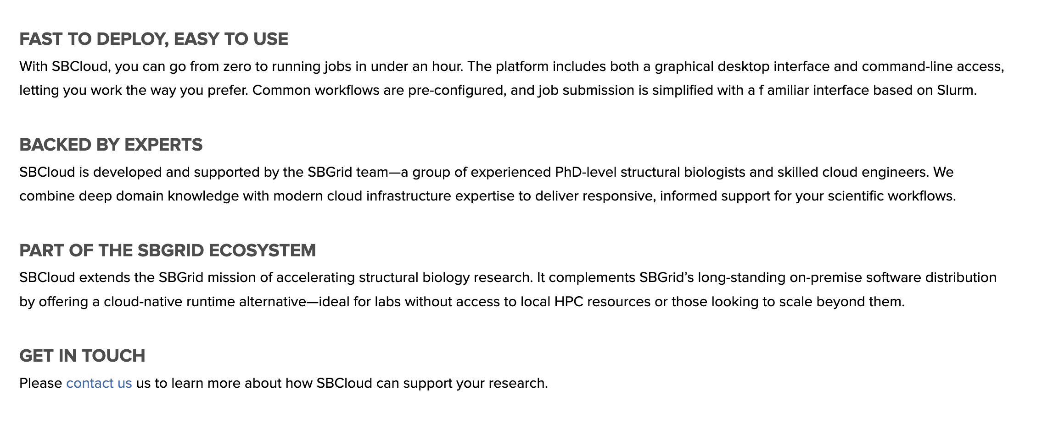
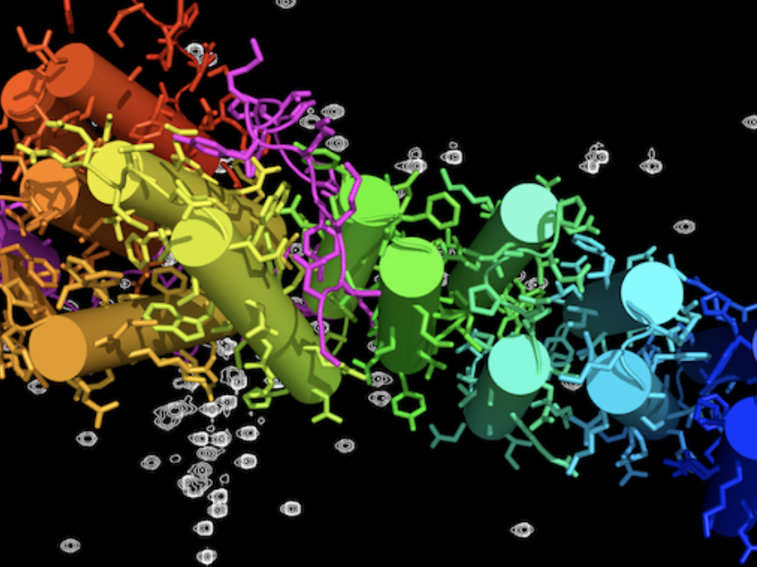
Enabling Technologies: SBCloud
Credit: Bill Clemons, CalTech
For context, please see: SBGrid Consortium

Slide 11
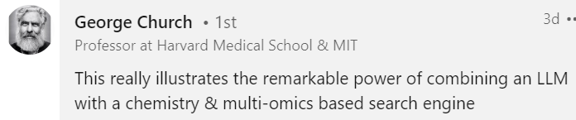
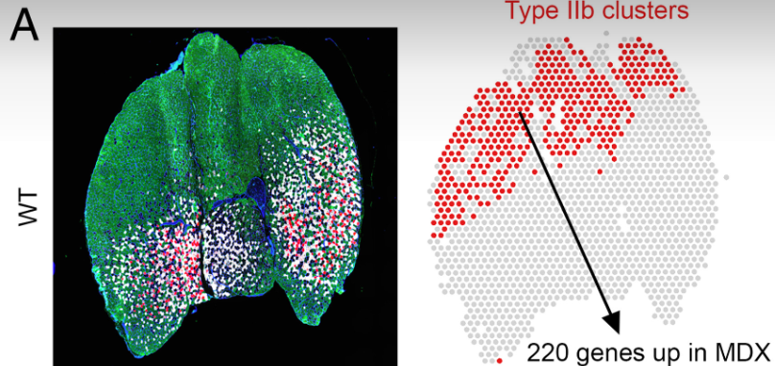
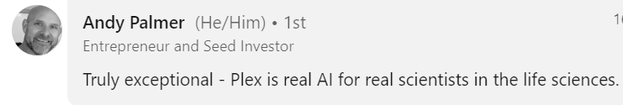
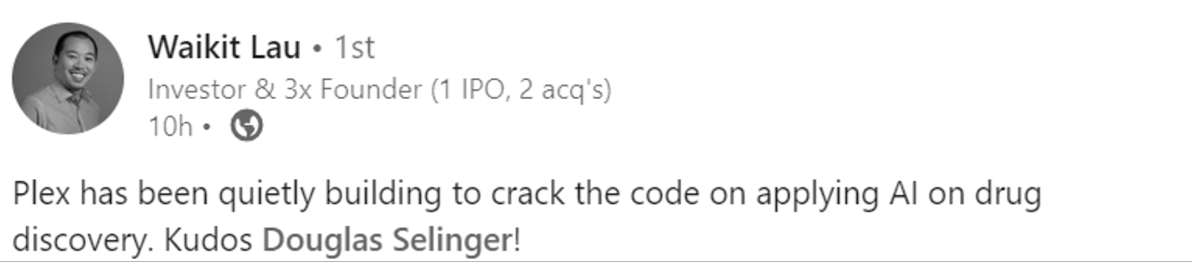
Enabling Technologies: Plex Research
Outperforms leading LLMs on key drug discovery tasks including:
Gene signature analysis
Target ID based on chemical structure
Detailed characterization of disease processes & putative modulators
Molecular target & Mechanism of Action (MoA)
More details, including testimonials and head-to-head comparisons:
Gene Signature Characterization | Chemical structure-based target prediction

Slide 12



Amazon Services to Build AI (or GenAI)
Amazon Q
Amazon Bedrock
Amazon SageMaker

Slide 13
Stephen Litster
Mike Tarselli
slitster@amazon.com
Tarselli@amazon.com

Slide 14
Backup

Slide 15
GenAI Innovation & Operational Excellence across the value chain
DISCOVERY AND DEVELOPMENT
Identify target molecules
Generate and enumerate structures
Optimize target sequences
Filter by attributes
Target identification
Target validation
Lead optimization
CLINICAL AND PRECLINICAL
Power the clinical development process from designing effective trials using analytics and ML capabilities, to accelerating the regulatory submission process.
Optimize resource allocation
Patient recruitment
Regulatory document management
Human-in-the-loop document generation based on MLR guidelines
SUPPLY CHAIN AND MFG
Invoice and ticket generation and ticket resolution
Risk identification and mitigation
Proactive maintenance order creation and communication
Summarization and quality scoring of RFI/RFP responses
Analysis and summarization of sustainability targets
COMMERCIAL
Patient support
Pro-active support to de-risk non-adherence
Marketing recommendations
Generate and optimize ad content
Medical Affairs literature analysis
Segment and analyze HCPs
Predict individualized patient outcomes
Sales: More efficient follow-up with HCP and Patients
Accelerate real-world evidence collection and management
Personalized content for patients
MONITORING
Adverse event intake forms
Adverse event monitoring
Translation of adverse event reports
Adverse event case narratives
Pharmaco-vigilance and periodic safety report generation
Notes:
Together with our partners, we offer purpose-built solutions, tools, and consulting practices across the value chain to help life sciences customers accelerate high-throughput modeling screening and conduct smarter clinical trials, all the way through effectively scaling and handling growing numbers and sources of adverse event data.

Slide 16


















Agentic Frameworks
API driven for extensible data, tools, & models
Functions
Core
Common
Fine tuned
Build new tools
Models
Public & Licensed Models
Step 1
Step 2
…
Step n
External Data
Internal Data
Agents for Amazon Bedrock
Users
AWS HealthLake
AWS Clean Rooms
Amazon DataZone
AWS HealthImaging
Amazon S3
Lab instruments
AWS HealthOmics
Amazon Redshift
LIMS/ELN
Notes:
Tools
Tools can be data stores or functions

